Slide 1
Python Objects

Slide 2
Agenda
Container/Collection Objects
List
Tuple
Dictionary
Set

Slide 3
Container or Collection Objects

Slide 4
Container or collection objects
Container or collection objects are objects that can hold any number of arbitrary objects
Container provides a way to access the child objects and iterate over them
Container or collection objects:
Dictionary
Tuple
List
Set

Slide 5
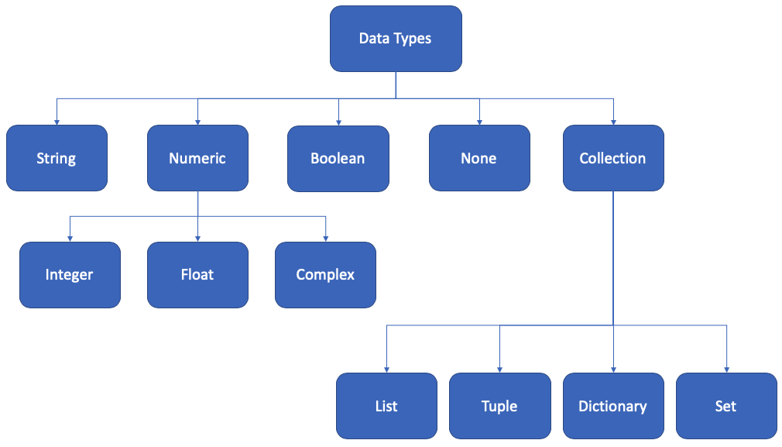

In our last session we covered...

Slide 6
We learn the following in our session today

Slide 7
List

Slide 8
List
A list is a container object
Heterogeneous sequence of elements
Can have duplicates
Mutable
Elements are separated by comma, enclosed in [ ] parenthesis
Supports the following:
Append new elements
Concatenate
Access using indexes or values
len(), min(), max()
in, not in

Slide 9
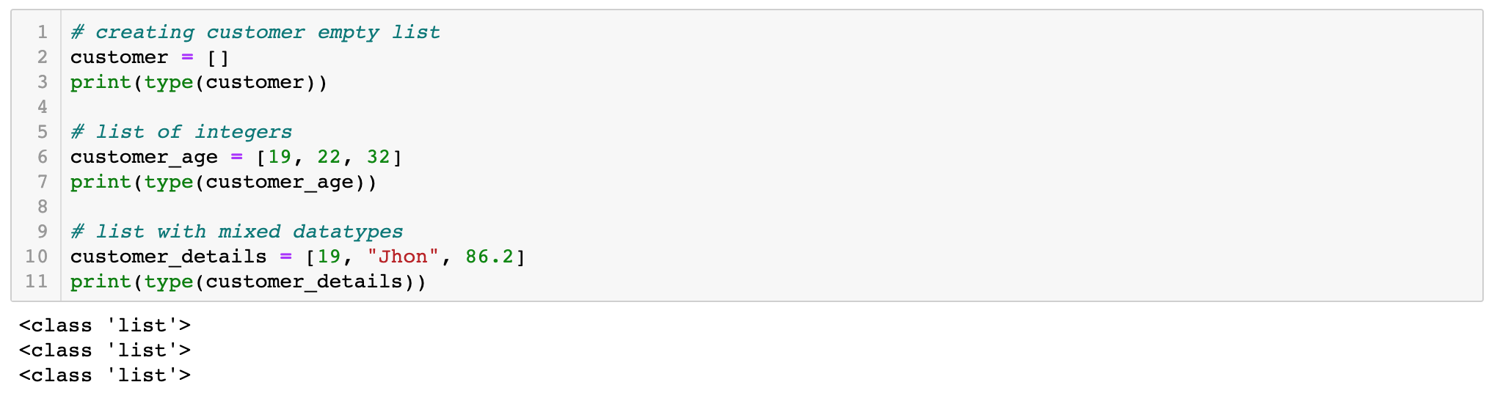
Creating lists

Slide 10
Creating nested lists
A list can even have another list as an item. This is called nested list.

Slide 11
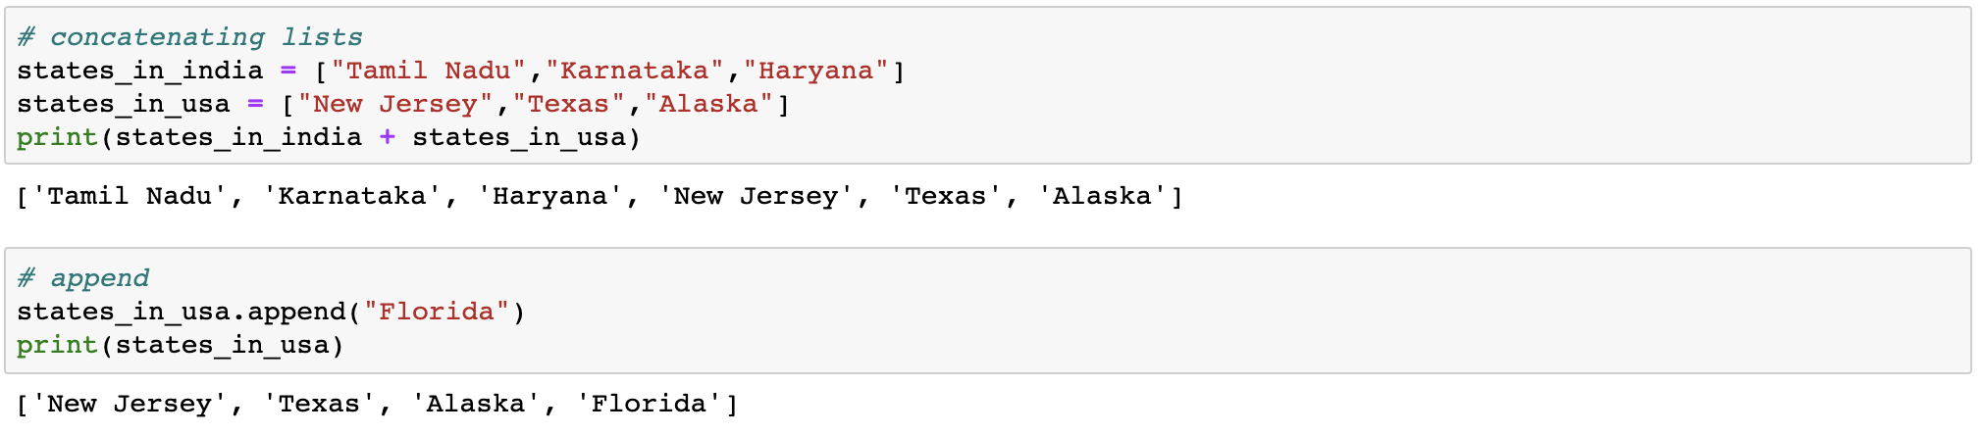
Concatenate and append in lists

Slide 12
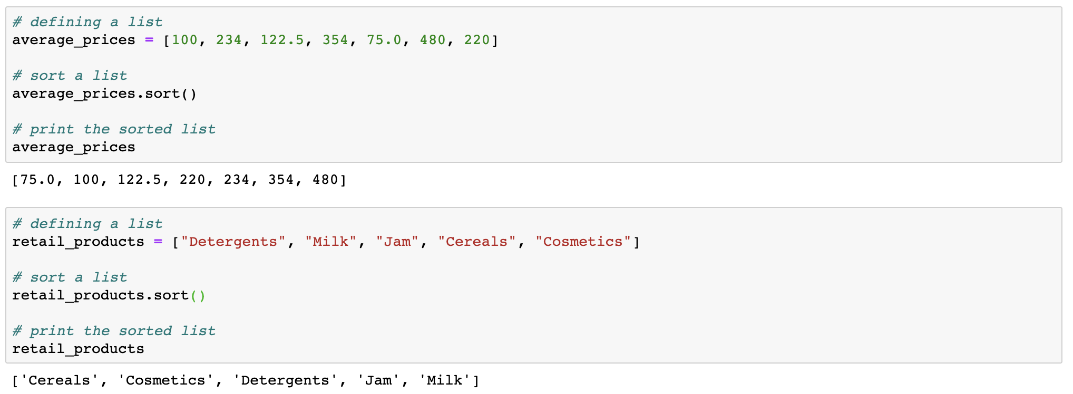
Sort a list

Slide 13

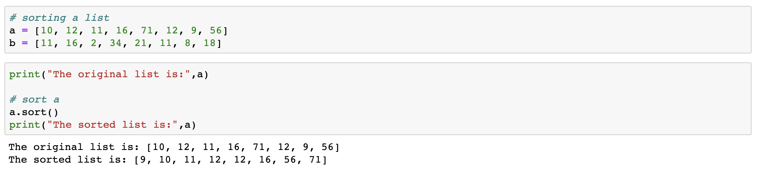
Sort the list in reverse order by passing the parameter reverse=True to the sort() function.
By default reverse is set to False

Slide 14

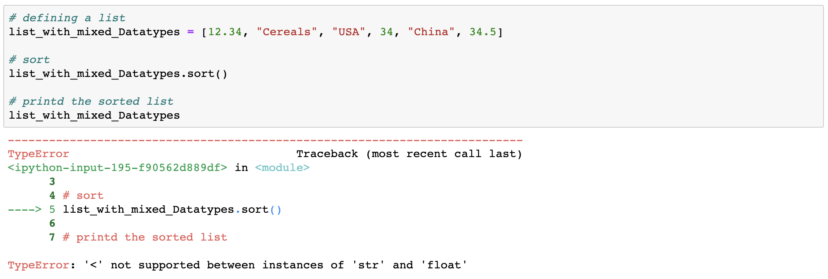
You cannot sort a list with mixed data types

Slide 15
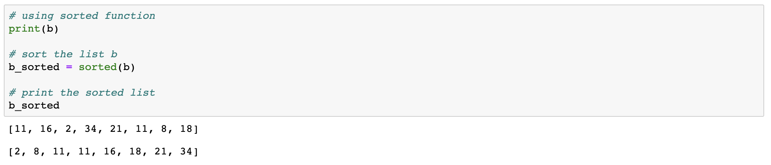
Sorting a list using the sorted() function

Slide 16
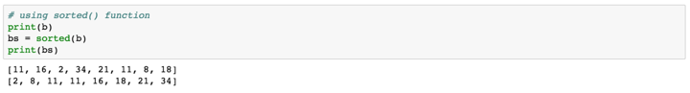
Sort the list in reverse order by passing the reverse=True parameter to the sorted() function

Slide 17

What is the difference between sort() and sorted()?
The sort() will modify an existing list but sorted() will create a new list.

Slide 18
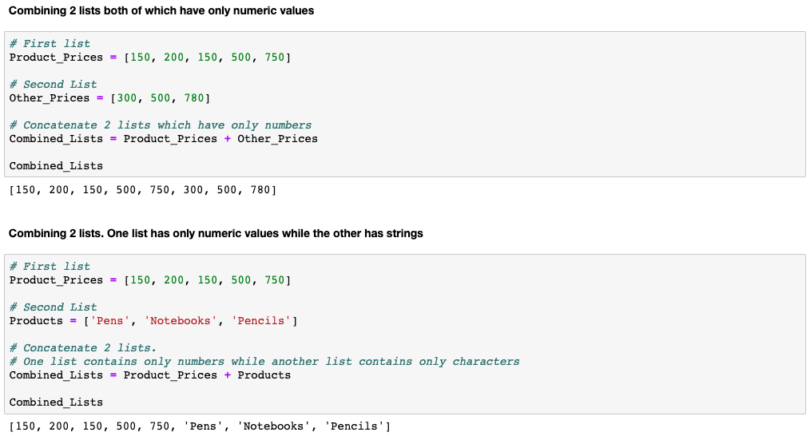
More list operations: concatenate lists

Slide 19
More list operations: concatenate lists

Slide 20
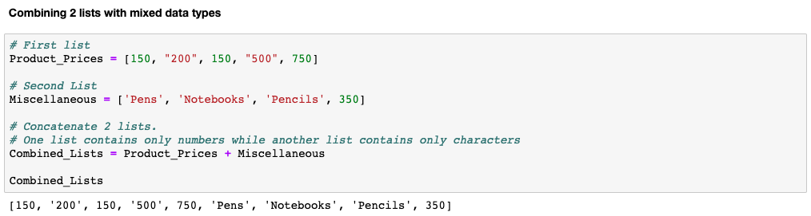
More list operations: concatenate lists

Slide 21
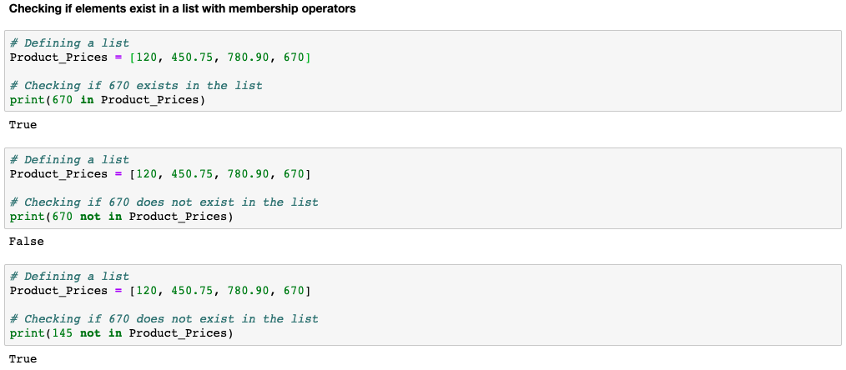
More list operations: with membership operator

Slide 22
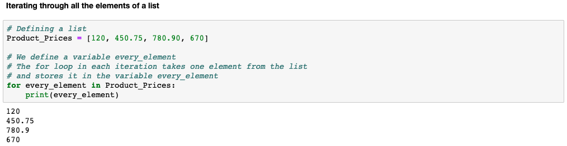
More list operations: iterating through a list

Slide 23
More list operations
We learn more operations that can be performed on a list:
Finding the number of elements in a list
Finding the maximum & minimum value of a list with numeric values
Append a new element to a list
Remove all elements from a list
Create a copy of the list
Count the number of occurrences of a specified element
Return an index position of an object
Insert a new element to a list at a specified index position
Delete an element from a list
Reverse a list
Sort a list

Slide 24
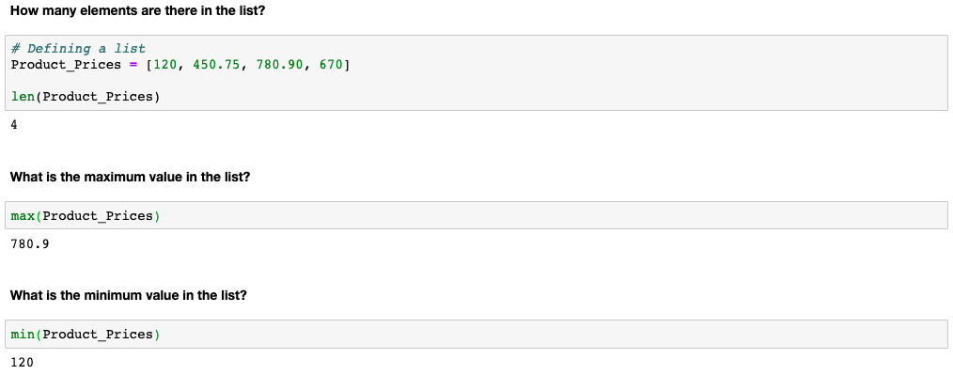
More list operations

Slide 25
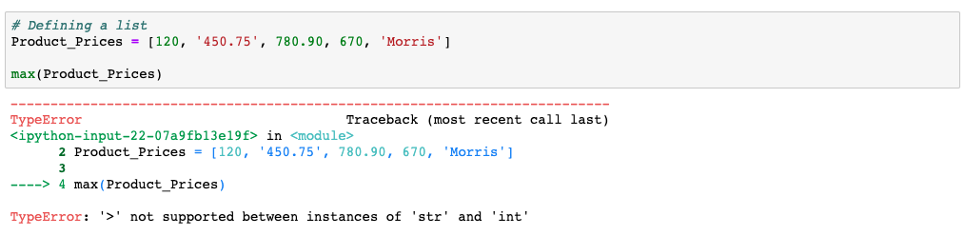
The max() & min() cannot be used on a list with mixed data types

Slide 26
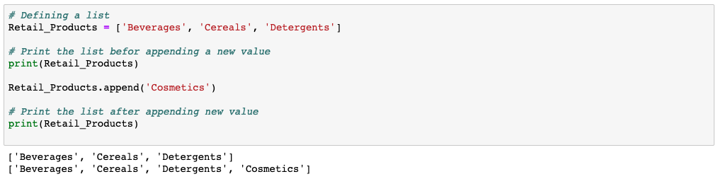
Append a new element to a list
Note that the new element gets inserted at the end of the list

Slide 27
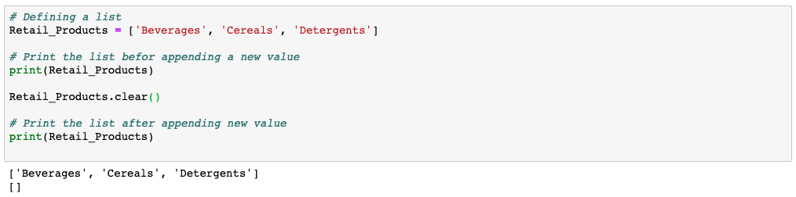
Remove all elements from a list
Note that all elements are removed but the list still exists. Though now its a blank list.

Slide 28
The list Retail_Products do not have any members now. Can you add new elements to the blank list?
Hint: use append() function

Slide 29
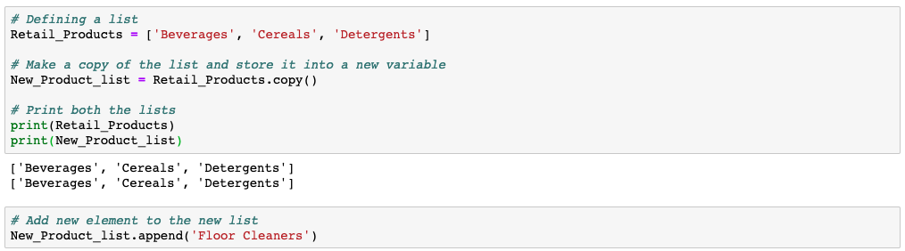
Making a shallow copy of an existing list
Note: A shallow copy is an actual copy of a list in a different variable

Slide 30
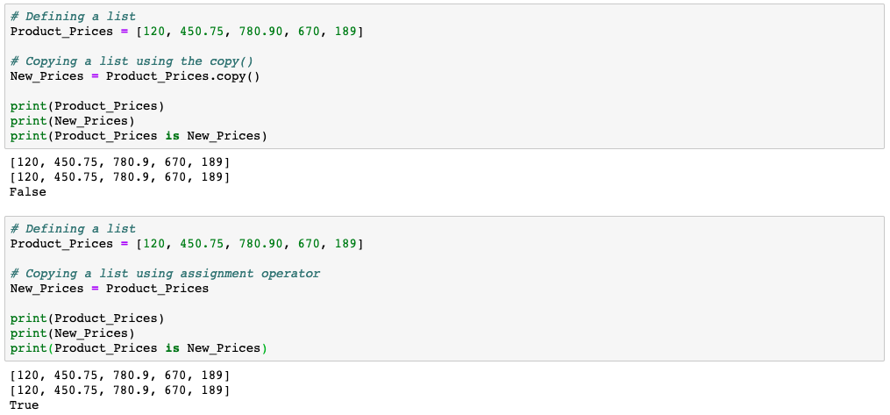
A shallow copy is the actual copy which gets created using the copy() function
Using the copy(), we get a shallow copy. Which means the 2 variables are different objects.
Using the assignment operator, we get a reference copy. Which means the 2 variables are referencing to the same list.

Slide 31
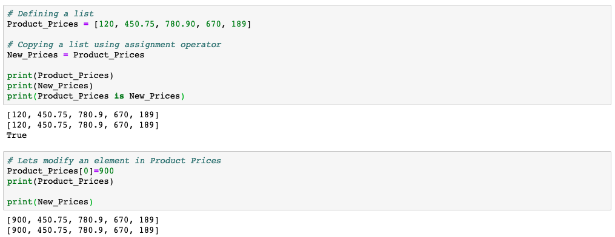
How a copy made using the assignment (=) operator behaves
Using the assignment operator, we get a reference copy. Which means the 2 variables are referencing to the same list.
Notice that we change the 1st element in Product_Prices. And it reflects in New_Prices.
This behaviour will not occur with the copy() function

Slide 32
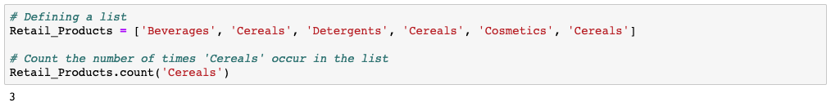
Count the number of occurrences of an element
You need to pass the element as an input parameter to the count() function. The function will count how many times ‘Cereals’ appear in the list.

Slide 33
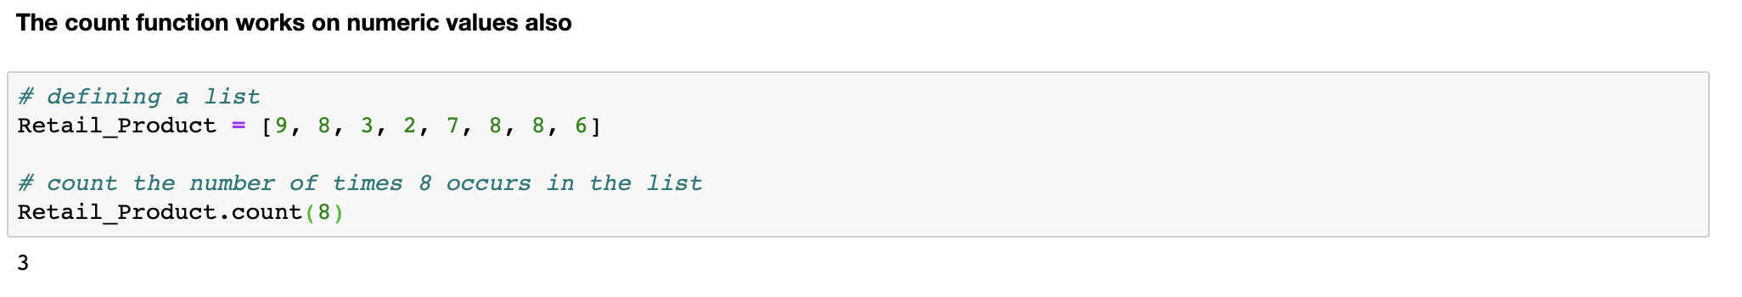
Count the number of occurrences of an element
You need to pass the element as an input parameter to the count() function. The function will count how many times 8 appear in the list.

Slide 34
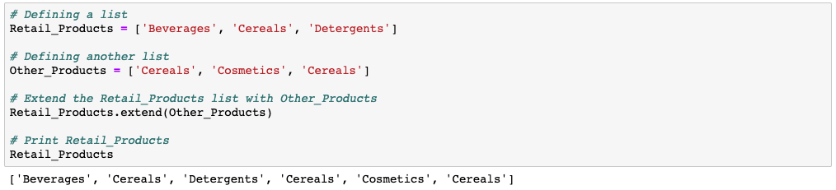
Extending a list by adding all elements of another list

Slide 35
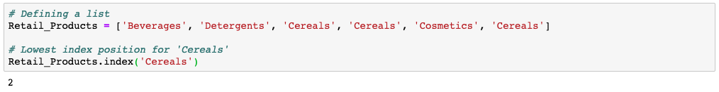
Returning the index position of an object
Note: This returns the lowest index position

Slide 36
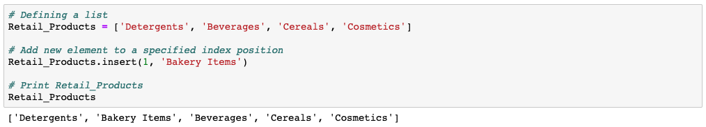
Insert a new element at a specified index position

Slide 37
Remove an element from a list
By index position
using pop()
By element name
using remove()

Slide 38

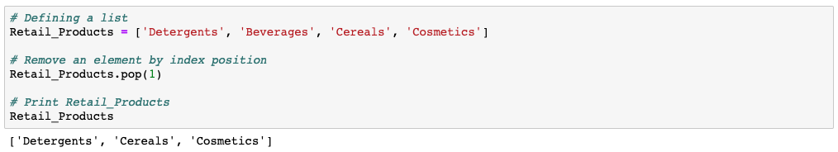
Remove an element by a specified index position

Slide 39

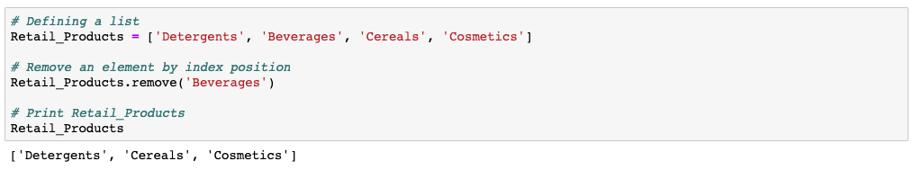
Remove an element by element name
Note that it removes the first occurrence of the element in case the element occurs multiple times.

Slide 40
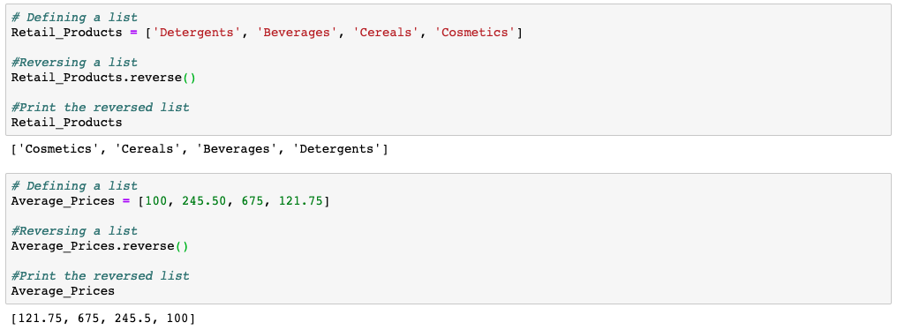
Reverse a list

Slide 41
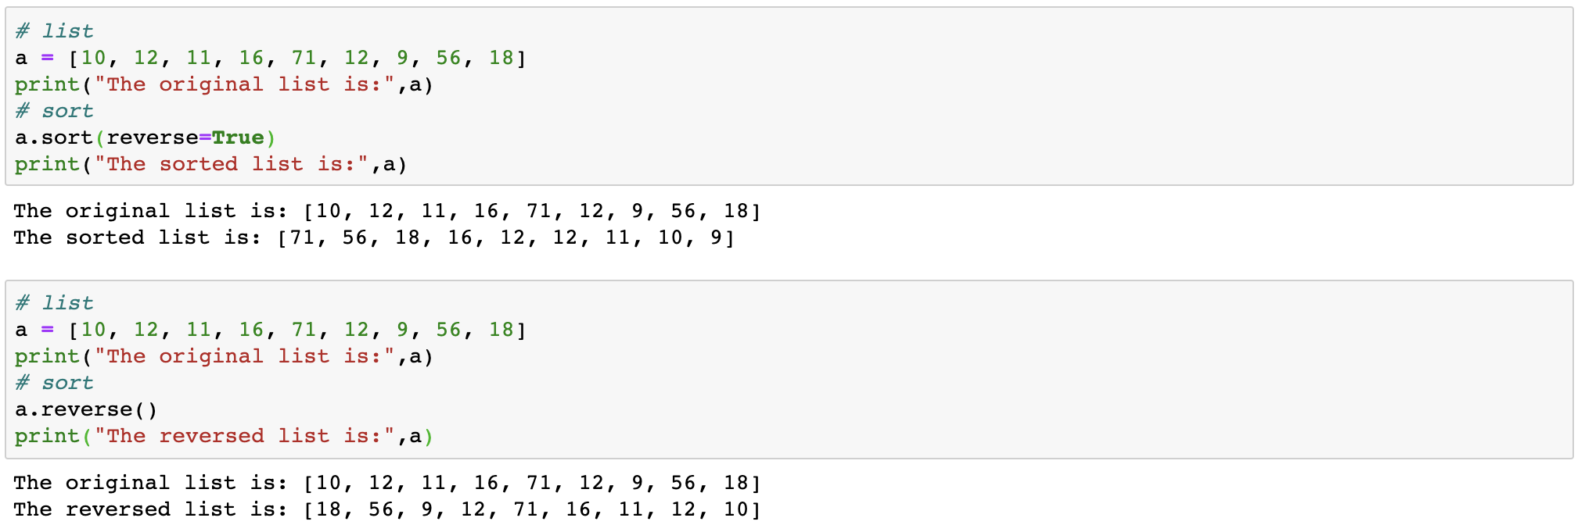
Note: The reverse() and the parameter reverse in the sort() are two different operations.

Slide 42
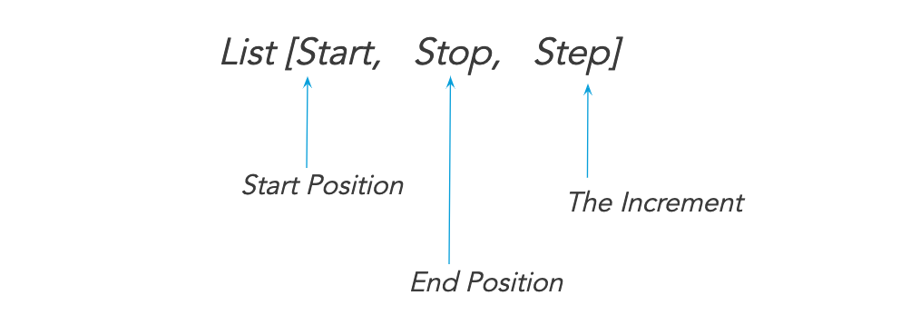
Slice a list

Slide 43
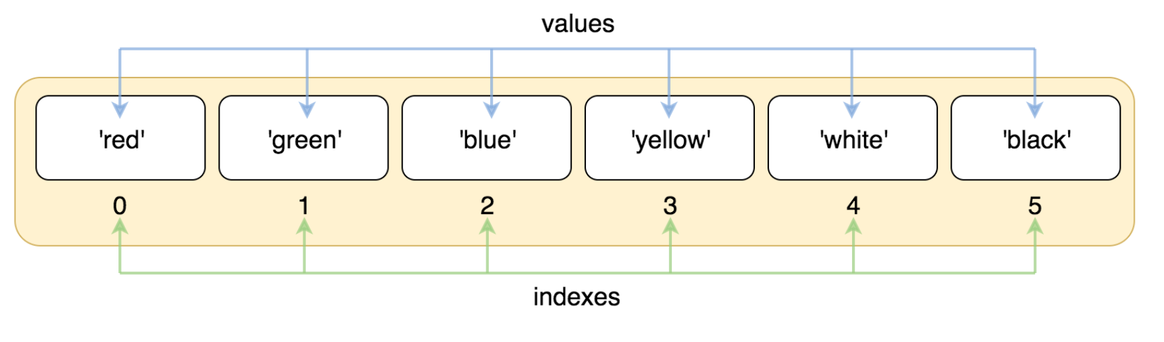
Slice a list: Indexes

Slide 44
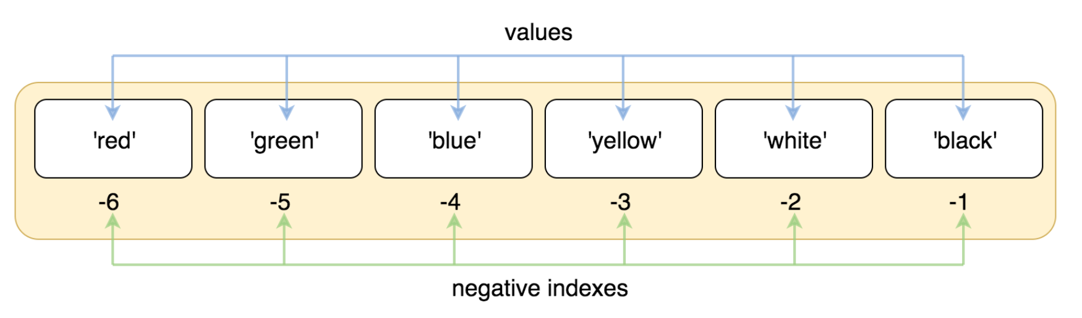
Slice a list: Negative Indexes

Slide 45
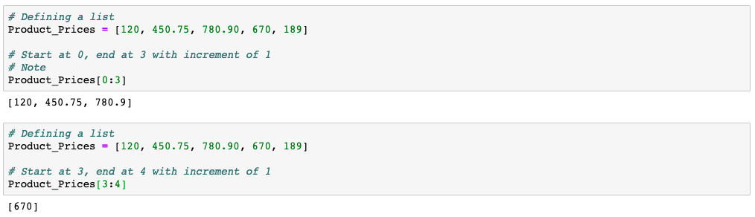
Slice a list: basic examples
Note that the element at the end position is not included

Slide 46
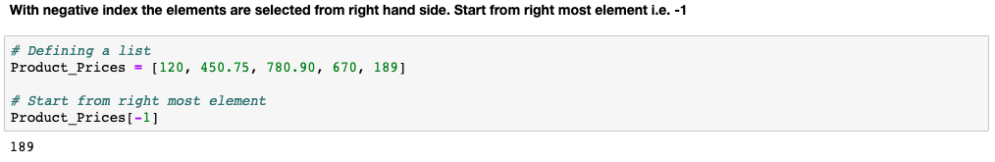
Slice a list: with negative index

Slide 47
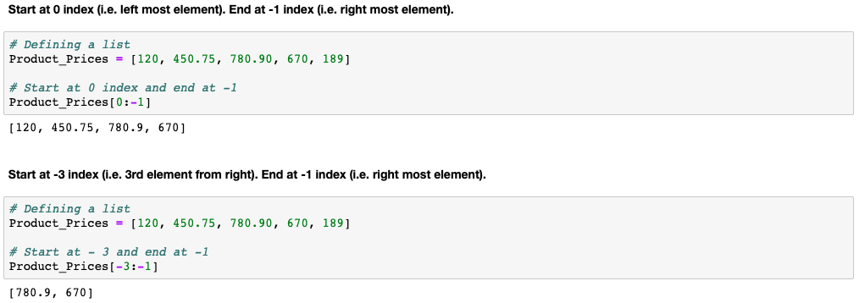
Slice a list: with negative index

Slide 48
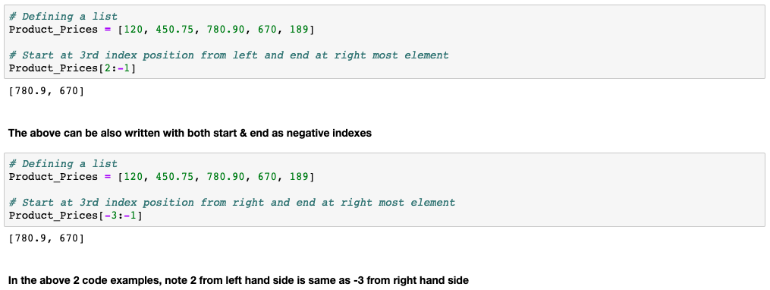
Slice a list: with positive & negative index

Slide 49
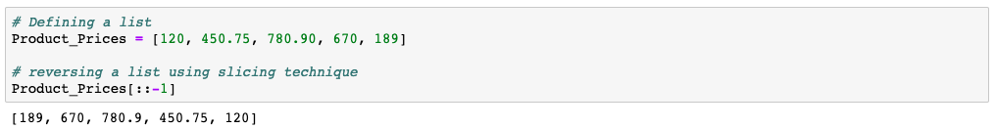
You can reverse a list with slicing technique?

Slide 50
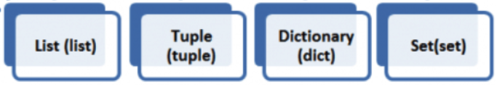


We learnt the list object...
Create using
[ ]
( )
{ }
{ }
Editable

Slide 51
Tuple

Slide 52
Tuples
Another type of container object
Heterogeneous sequence of elements
Can have duplicates
Immutable
Elements are separated by comma, enclosed in ( ) parenthesis
Supported operations:
in, not in
len(), min(), max()
Compare
Concatenate, Slice, Index

Slide 53
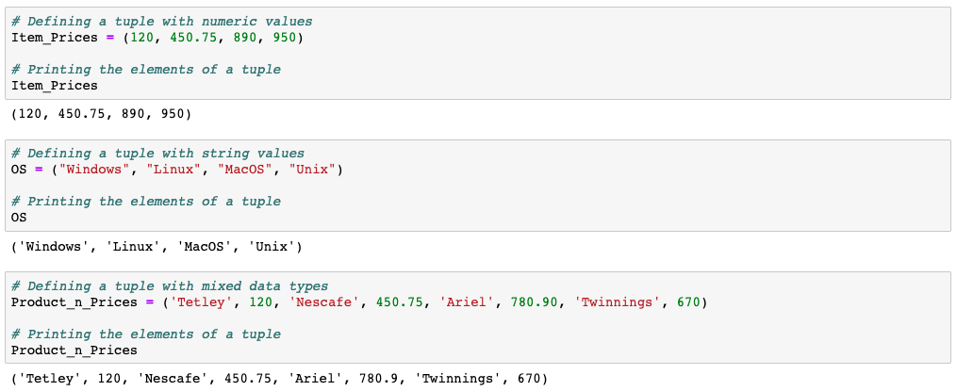
Create tuple

Slide 54
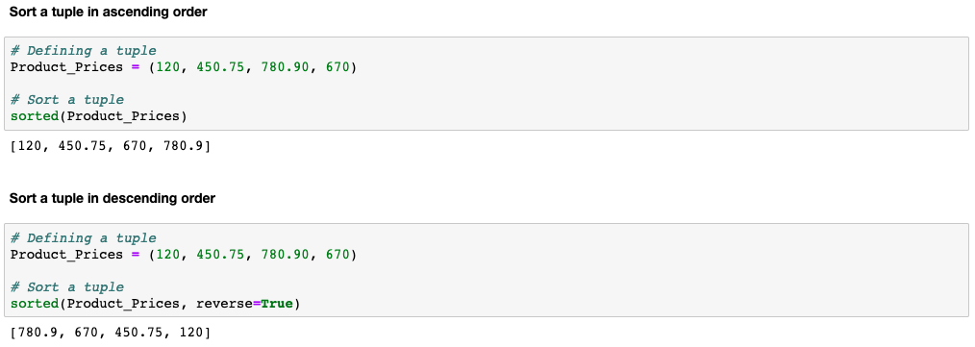
Sort a tuple

Slide 55
List has a sort() function but a tuple does not have a sort() function. However, you can use the sorted() function to sort both a list & a tuple

Slide 56
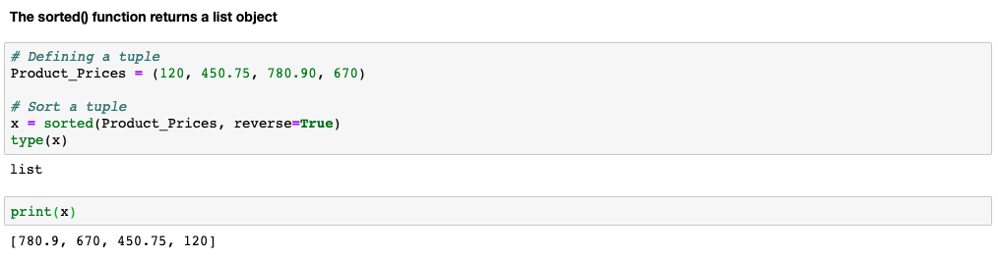
The sorted() returns a list even if you pass a tuple to it.
Store the result of the sorted() function in x and check the type of the x variable.

Slide 57
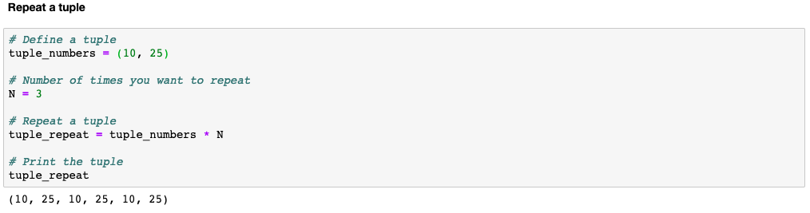
Tuple operations

Slide 58
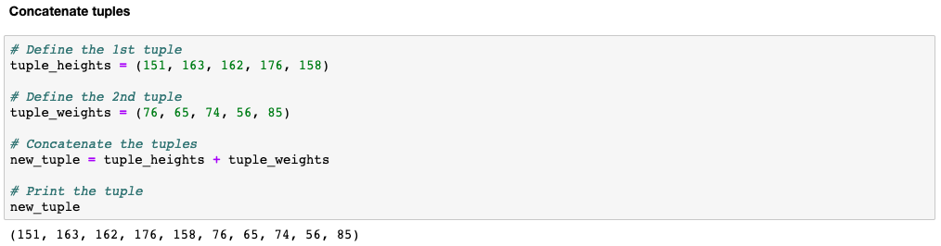
Tuple operations

Slide 59
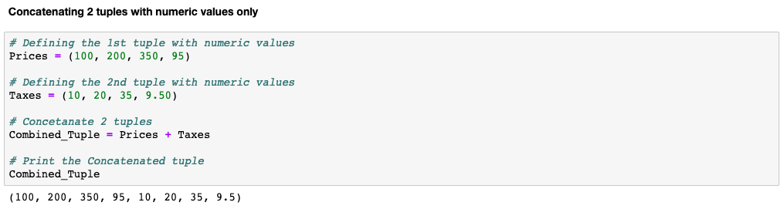
More tuple operations: concatenate tuples

Slide 60
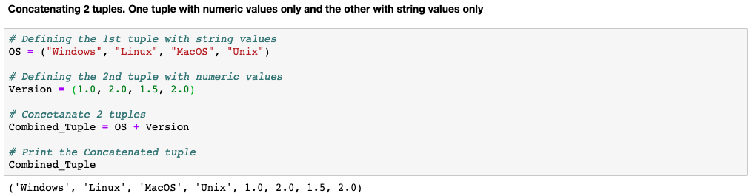
More tuple operations: concatenate tuples

Slide 61
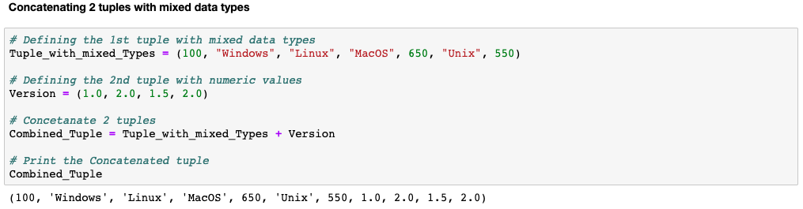
More tuple operations: concatenate tuples

Slide 62
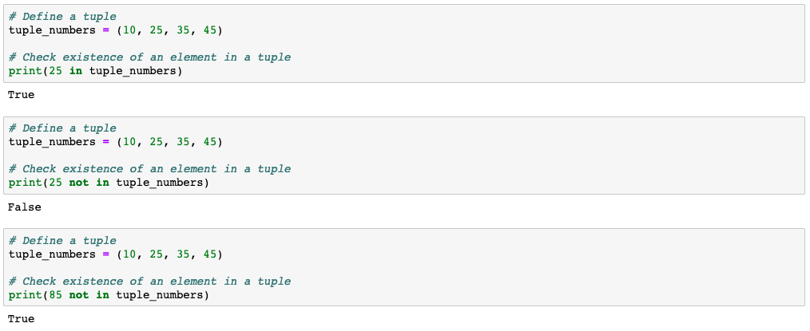
More tuple operations: with membership operator

Slide 63
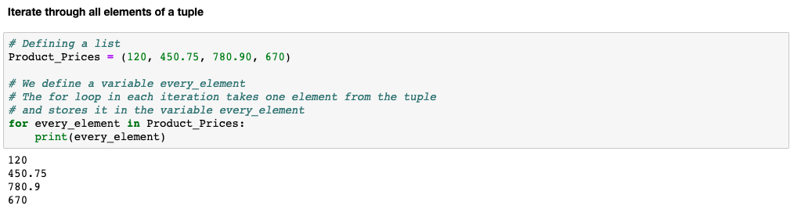
More tuple operations: iterating through a tuple

Slide 64
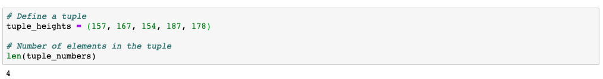
More tuple operations
How many elements are there in the tuple

Slide 65
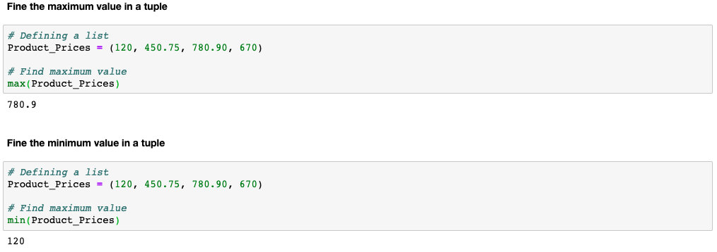
More tuple operations

Slide 66
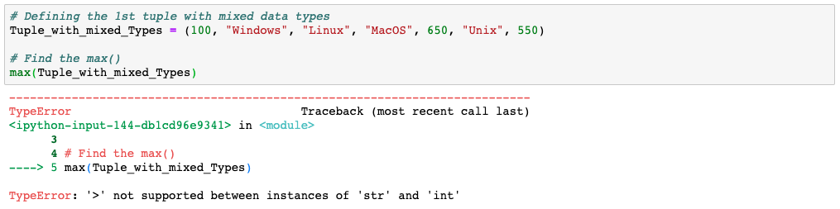
The max() & min() cannot be used on a tuple with mixed data types

Slide 67

Elements cannot be deleted or appended in a tuple because a tuple is immutable

Slide 68

You can have a list within a tuple?
And you can append elements to a list within the tuple?
A list is added within a tuple
100 got appended to the list within the tuple. Note: Tupe does not have an append() function

Slide 69
Slice a tuple
tuple [Start, Stop, Step]

Slide 70

Slice a tuple: basic examples
Note that the element at the end position is not included

Slide 71
Because tuple is immutable, a tuple needs lesser memory than lists.

Slide 72

Lesser memory fragmentation is better in terms of performance. Python can reuse a tuple which results in reduction of memory fragmentation and can speed up memory allocations. If a tuple is no longer required and has less than 20 elements, instead of deleting it permanently, Python reserves it temporarily.

Slide 73
We learnt list & tuple...
Create using
[ ]
( )
{ }
{ }
Editable

Slide 74
Dictionary

Slide 75
Dictionary object
A Python dictionary is a mapping of unique keys to values
Use {} curly brackets to construct the dictionary
[] square brackets to index it
Dictionaries are mutable
We will learn how to:
Access values in a dictionary
Update dictionary
Delete dictionary elements

Slide 76

A sample dictionary object
Item 1
Key 1
Value 1
Key 2
Value 2
Item 2

Slide 77

Dictionary object

Slide 78
Dictionary object

Slide 79
Nested Dictionary
Creating a nested dictionary object:
Accessing elements from nested dictionary

Slide 80

Dictionary object

Slide 81

Dictionary object

Slide 82

Dictionary object: Default dictionary
This throws an error because the count is not initialized and we are trying to add 1 to an uninitialized value

Slide 83
Dictionary object: Default dictionary
In order to avoid the error for uninitialized values, we use defaultdict()
Import the defaultdict from collections module
Initialize the dictionary object with defaultdict()
Note: We passed int() to the defaultdict()
When the dictionary object encounters a key that was not seen before, it initializes the key with a value returned by int(), in this case 0 (zero)

Slide 84

Dictionary object: Default dictionary
Import the defaultdict from collections module
Initialize the dictionary object with defaultdict()
Note: We passed int() to the defaultdict()
When a dictionary object encounters a key that was unseen before, it initializes the key with a value returned by int(), in this case 0

Slide 85

Loop through the dictionary object
Use keys() to loop through the keys in the dictionary object
Use values() to loop through the values in the dictionary object

Slide 86

Built-in dictionary functions

Slide 87

Built-in dictionary functions

Slide 88

Built-in dictionary functions

Slide 89

Built-in dictionary functions
There is no customer ‘Sam’ in the keys. Thus, get() returns ‘None’ as value

Slide 90

Built-in dictionary functions

Slide 91

Built-in dictionary functions

Slide 92

Built-in dictionary functions

Slide 93

Create a dictionary using two lists
zip() pairs the corresponding elements as a key and value from the lists

Slide 94
A Python list as well as a tuple can be used as a value in the dictionary. In other words each item in a tuple/list can be a key in a dictionary when you convert it to a dictionary object.

Slide 95
A tuple is immutable. However, if the tuple contains a list or a dictionary inside it, then the list or the dictionary that is contained within the tuple can be modified.

Slide 96
We learnt list, tuple and dictionary...
Create using
[ ]
( )
{ }
{ }
Editable

Slide 97
Set

Slide 98
Sets
Sets are very similar to list data structures
Do not allow duplicates
Unordered collections of homogeneous elements
Sets are generally used to remove duplicate elements from a list

Slide 99

Sets
Sets supports the following operations:
Intersection
Union
Difference
Symmetric Difference

Slide 100

Sets

Slide 101

Sets

Slide 102

Set operations: union

Slide 103
Set operations: intersection

Slide 104

Set operations: difference

Slide 105

Set operations: symmetric difference

Slide 106
We learnt the collection objects...
Create using
[ ]
( )
{ }
{ }
Editable

Slide 107
Thank You

